Slide 1


Session 03 / introduction to Functional Programming
Skilling up the organization

Slide 2
_Session 03 / _INTRODUCTION
This deck will try to give an easy approach into functional programming
Functional programming is relevant for every programmer as it provides a greater comprehension on how does the code behave and provides several tools for improving performance and reliability.
Aim is to provide a basic understanding on several functional programming features.
Every topic is covered in an introductory level, there is much more material for every topic if you wish to dig in. They come from a very developed field of mathematics: lambda calculus and category theory.

Slide 3
_Session 03 / _Main Principles
Functions are pure and have referential transparency.
Software is meant to be composed.
Functions are first-class and can be higher-order.
Variables are immutable.
Rely on recursion instead of while or for loops.

Slide 4
_Session 03 / _Purity
Given the same input, will always return the same output. (Idempotency)
Produces no side effects
Can deal with side effects by:
Dependency injection, not ideal as often used for impure code
Lazy functions, existing in C# as Lazy<T>
Effect functor (also known as IO)

Slide 5
_Session 03 / _Purity
Dependency injection: we take any impurities in our code, and shove them into function parameters.
Disadvantage: The main one is that you end up with lengthy function signatures.
Lazy functions: instead of executing the side effect, we return a function that will perform that side effect.
Effect functor: is an object where we inject our side effect function and that lets us compose with the eventual return value of that function as if it was executed but delaying the actual side effect until the last moment.

Slide 6
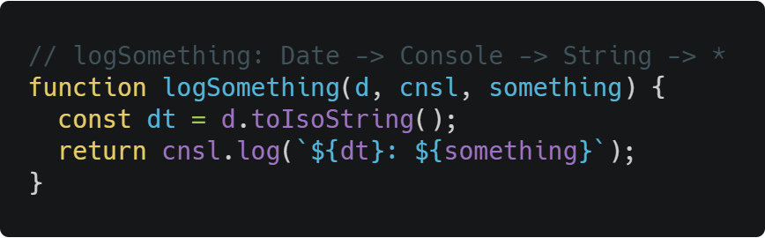
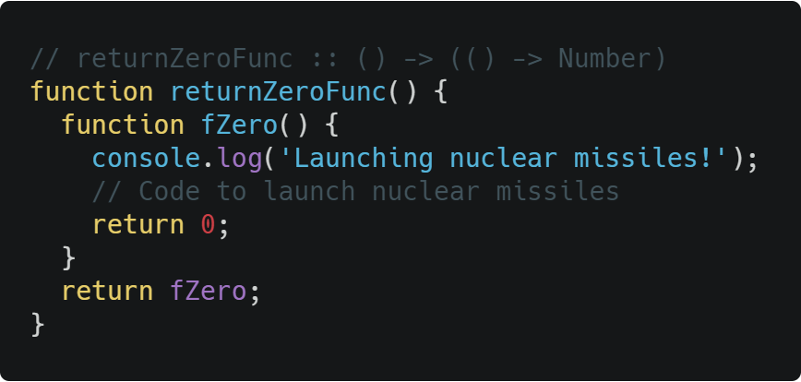
_Session 03 / _Purity
Dependency injection
Lazy functions

Slide 7
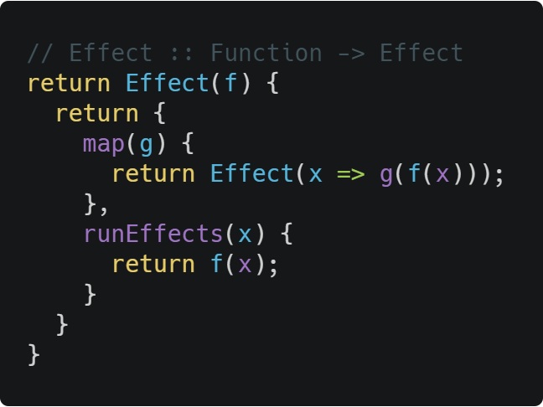
_Session 03 / _Purity
Effect functor

Slide 8
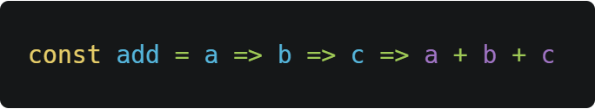
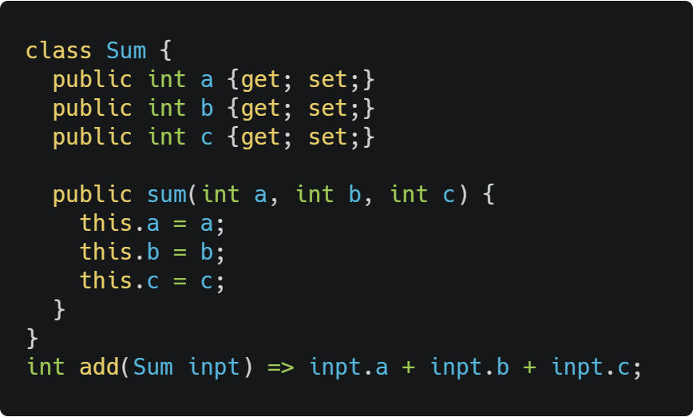
_Session 03 / _Composition
Functions must be designed with composition in mind. This means that the output of one function must be the input of the next one.
Curry: is a method for transforming one function that is meant to receive more than one parameter into a function receiving one argument that returns a functions receiving one argument and so on:
Creating complex object types that group the input parameters is another technique that enforce the composition. (A good practice anyway)

Slide 9
_Session 03 / _Composition
Object composition allows the creation of complex data types by inheriting behaviors and properties of simpler objects.
Object composition can be done with class inheritance, but this comes with a lot of problems and there are much better solutions:
The fragile base class problem
The gorilla/banana problem
The duplication by necessity problem

Slide 10
_Session 03 / _Composition
Aggregation: Aggregation composes objects into enumerable collections where each member of the collection retains its own identity.
When to use
Whenever there are collections of objects which need to share common operations, such as iterables, stacks, queues, trees, graphs, state machines, or the composite pattern (when you want a single item to share the same interface as many items).
Considerations
Aggregations are great for applying universal abstractions, such as applying a function to each member of an aggregate (e.g., array.map(fn)), transforming vectors as if they're single values, and so on. If there are potentially hundreds of thousands or millions of subobjects, however, stream processing may be more efficient.

Slide 11
_Session 03 / _Composition
Concatenation: composes objects by extending an existing object with new properties.
When to use
Any time it would be useful to progressively assemble data structures at runtime, e.g., merging JSON objects, hydrating application state from multiple sources, creating updates to immutable state (by merging previous state with new data), etc…
Considerations
Be careful mutating existing objects. Shared mutable state is a recipe for many bugs.
It’s possible to mimic class hierarchies and is-a relations with concatenation. The same problems apply. Think in terms of composing small, independent objects rather than inheriting props from a “base” instance and applying differential inheritance.
Beware of implicit inter-component dependencies.
Property name collisions are resolved by concatenation order: last-in wins. This is useful for defaults/overrides behaviour, but can be problematic if the order shouldn’t matter.

Slide 12
_Session 03 / _Composition
Delegation: composes objects by linking together an object delegation chain where an object forwards or delegates property lookups to another object.
When to use
Conserve memory: Any time there may be potentially many instances of an object and it would be useful to share identical properties or methods among each instance which would otherwise require allocating more memory.
Dynamically update many instances: Any time many instances of an object need to share identical state which may need to be updated dynamically and changes instantaneously reflected in every instance.
Considerations
Delegation can be used to exactly mimic the behaviour and limitations of class inheritance. Avoid is-a thinking.
Delegation saves memory at the cost of property lookup performance, however, even in the slowest case, property lookup performance is measured in millions of ops per second.
Need to differentiate between instance state, and delegate state.
Shared state on dynamic delegates is not instance safe. Changes are shared between all instances. Shared state on dynamic delegates is commonly a bug..

Slide 13
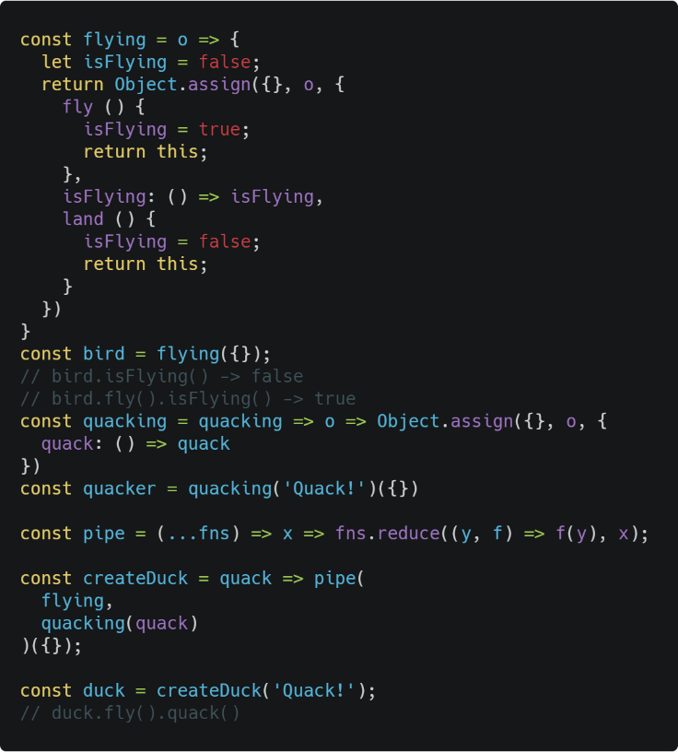
_Session 03 / _Composition
Mixins: Functional mixins are composable factory functions which connect together in a pipeline; each function adding some properties or behaviors like workers on an assembly line. Functional mixins don’t depend on or require a base factory or constructor.

Slide 14
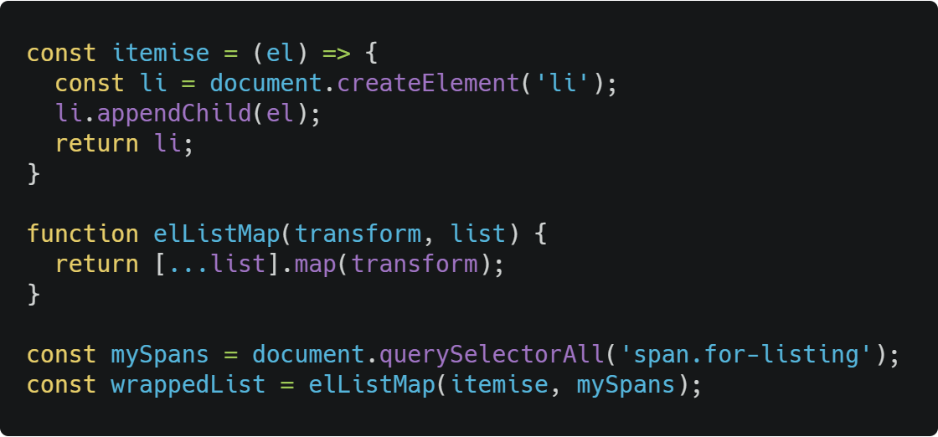
_Session 03 / _HOF
A higher order function is a function that takes a function as an argument, or returns a function.
This can be specially useful in frontend components (HoC)

Slide 15
Advanced Functional Programming
Algebraic structures

Slide 16
_Session 03 / _advanced Topics
Algebraic structures
Functor
Monad
Yoneda and Coyoneda
Lenses
Transducers
Monoids, Semigroups and others

Slide 17
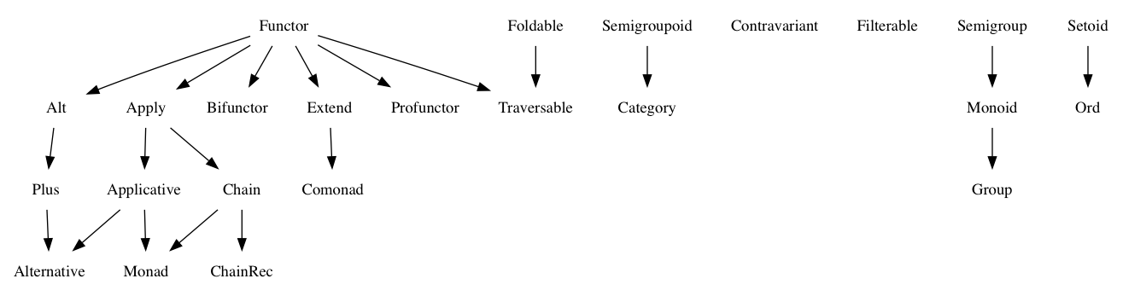
_Session 03 / _Algebraic Structures
An algebra is a set of values, a set of operators that it is closed under some laws it must obey.

Slide 18
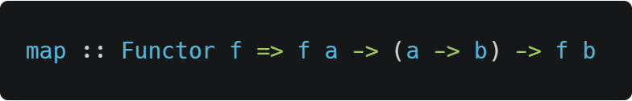
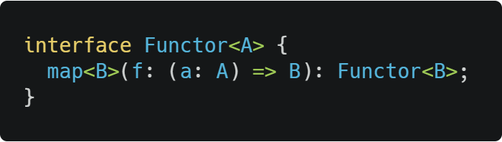
_Session 03 / _Functor
The functor structure must have a .map() method with the following type signature:
Hindley-Milner notation:
Typescript like notation:
The .map() method takes a function as an argument.
That function must take something of type a and transforms it into something of type b. The types a and b can be anything—even the same type.
When you call .map() on a functor of a, you’ll get back a functor of b.
Notes:
Array is a functor, as well as Maybe, Either, Effect

Slide 19
_Session 03 / _Functor
Arrays, they are by far the most common functor, providing a type lift, usually [a] is enough to create a singleton list with a as its own element. And some way of mapping.
In Javascript map
In C# you can use Select with the functional library linQ.
Maybe is another rather common functor, it provides the possibility that a value may or may not exists, is useful as return type for some validation functions.
Either, the default design pattern functor for handling errors, everything that lays down on the left side is passed down unaltered till the end.
Notes:
Array is a functor, as well as Maybe, Either, Effect

Slide 20
_Session 03 / _Monad
A monad is a monoid in the category of endofunctors.
A monad is a special type of functor that maps from one category to the same category. This is more formally called endofunctor.
Ex. F a -> G a
As it is still a functor it has the same properties and methods as a functor, hence they have the map.
Multiplication ⊗, sometimes referred as Monadic Bind, or Chain in the programming environment. It allows a Monad to be composed with another monad of the same category.
Ex. M(M(a)) -> M(b)
Unit, also known as lift. It allows to wrap some context into some type.
Ex. Int -> Monad(int)

Slide 21
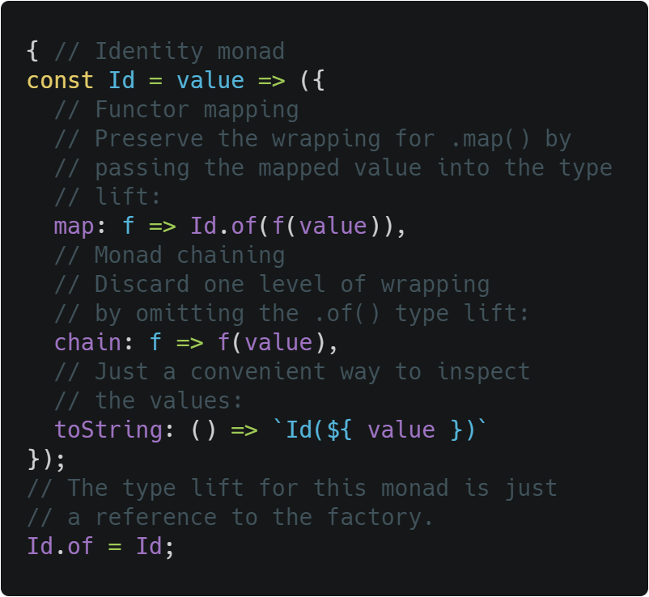
_Session 03 / _Monad
The monad in programming is a common design pattern that allows us to encapsulate side effects.
One of the results we get by having the multiplication in Monads is that we get an unwrap method for the Monad. This is because we can define the bind method as: (>>=) :: m a -> (a -> m b) -> m b
Left identity: unit(x).chain(f) == f(x)
Right identity: m.chain(unit) == m
Associativity: m.chain(f).chain(g) == m.chain(x => f(x).chain(g))

Slide 22
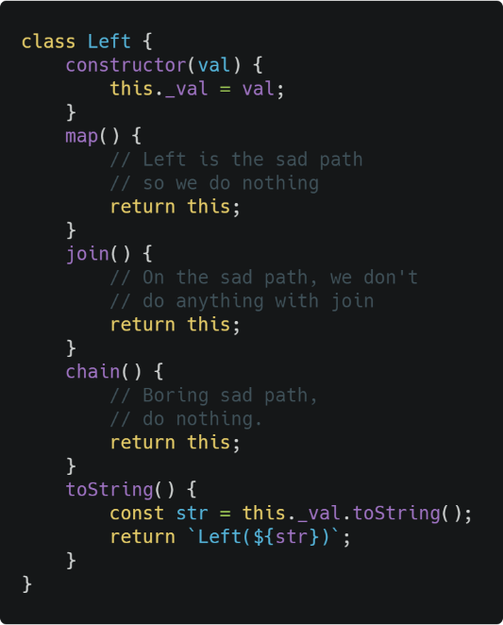
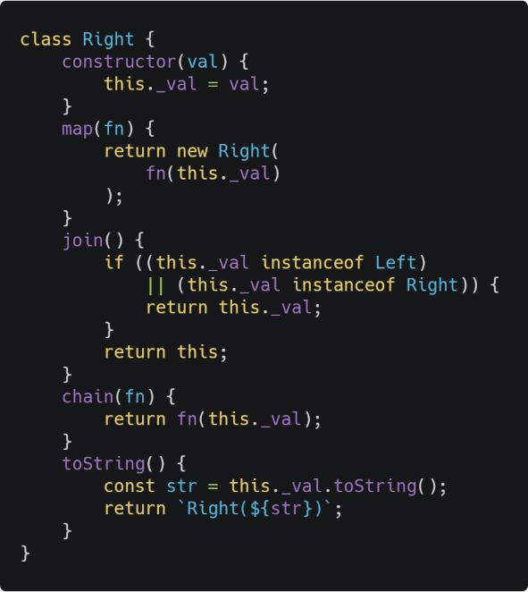
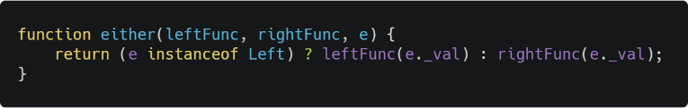
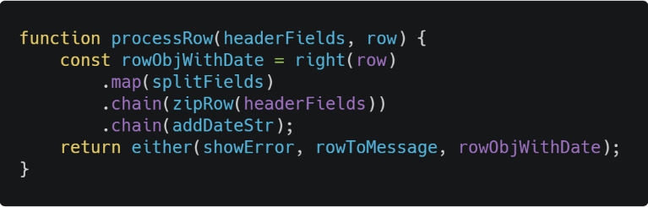
_Session 03 / _Monad
Example: The either monad is an example of how to use monads for error handling instead of the throw catch pattern.

Slide 23
_Session 03 / _Yoneda y Coyoneda
Yoneda and Coyoneda are two very useful patterns to work with large amount of data.
They work by creating a lazy application with map that gets executed once you execute the “run” method.
The difference between them is that Yoneda works with functors and Coyoneda works from base types.

Slide 24
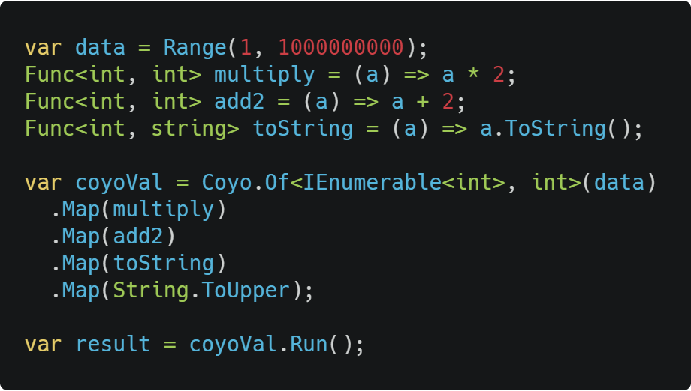
_Session 03 / _Yoneda y Coyoneda
Ex: Instead of applying the transformations multiply, add2, toString and String.ToUpper to an array of 100000000 numbers, it will compose multiply ∘ add2 ∘ toString ∘ String.ToUpper and applies the resulting function to the array. Hence instead of doing multiple passes through the list it only iterates once.
Notes:
This example Works on a Functor due to IEnumerable, hence it should be a yoneda, but the implementation is a coyo because its an abstract tool that is prepared to work on functors or base types.

Slide 25
_Session 03 / _Lenses
A lens is an accessor for getting/setting a field in a data structure.
Lenses allow us to treat object properties as first-class values, so they can be stored in variables, and passed into and out of functions. Hence we can access or modify our object properties in a composable context.
Lenses allow us to modify object properties in a composable manner.

Slide 26
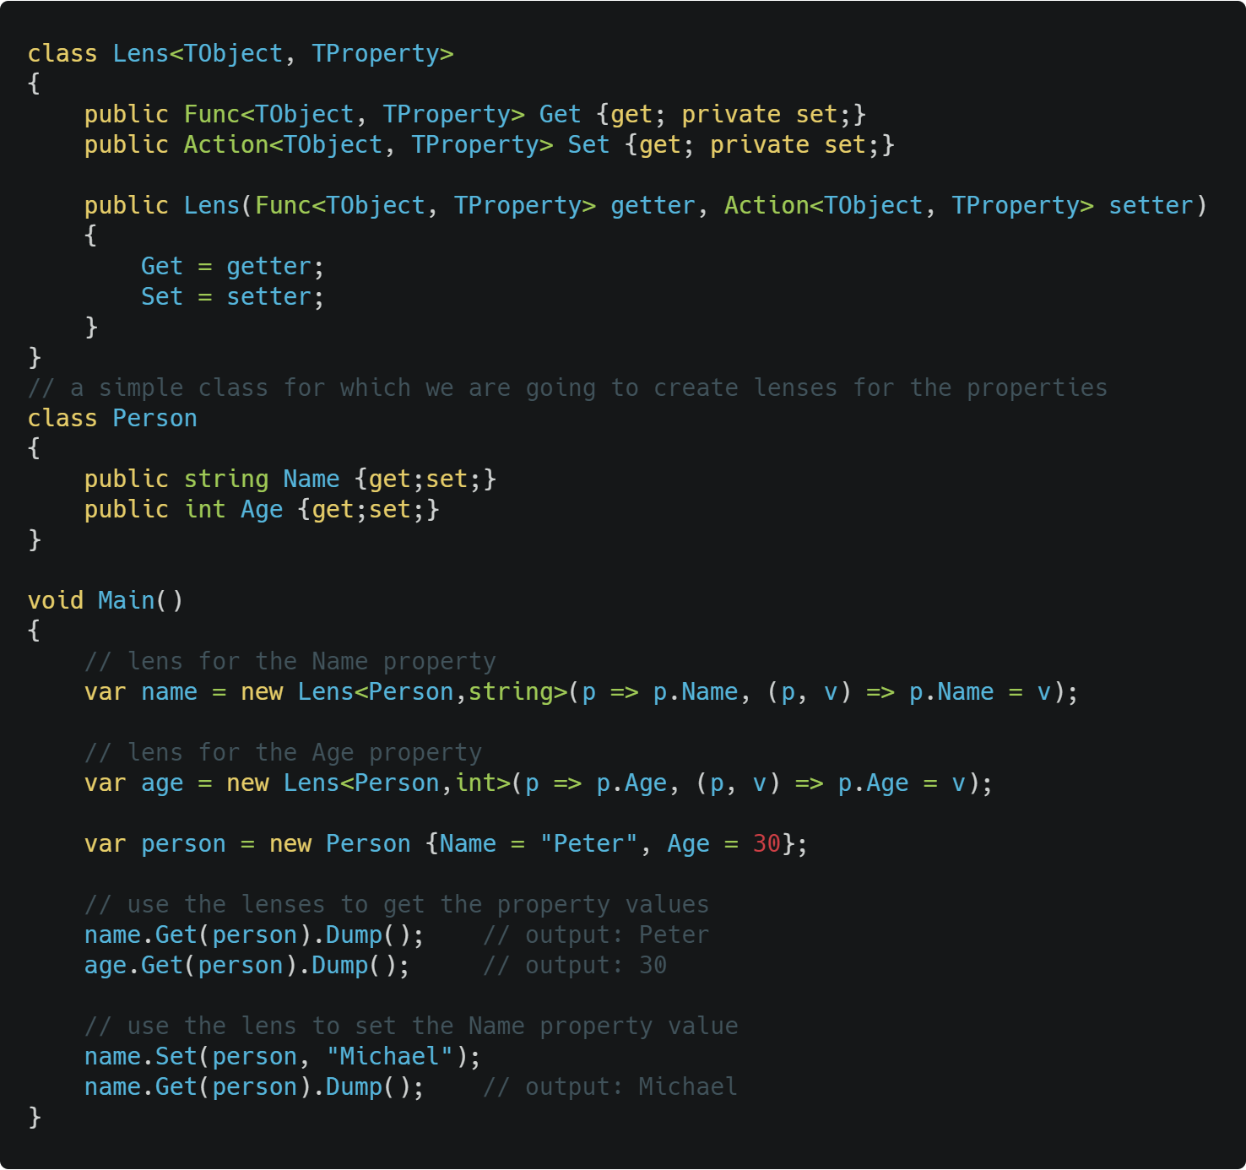
_Session 03 / _Lenses

Slide 27
_Session 03 / _Transducers
Composable higher-order reducer.
Composable using simple function composition
Efficient for large collections or infinite streams: Only enumerates over the elements once, regardless of the number of operations in the pipeline
Able to transduce over any enumerable source (e.g., arrays, trees, streams, graphs, etc…)
Usable for either lazy or eager evaluation with no changes to the transducer pipeline.

Slide 28
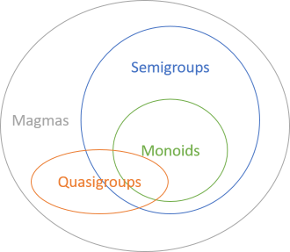
_Session 03 / _Monoids, semigroups and others
Monoids form a subset of semigroups.
Associative
Binary operations: addition and multiplication.
With a neutral element.
Semigroups form a subset of magmas.
Associative
Binary operations: addition and multiplication
Quasigroups form a subset of magmas
Binary operation: subtraction
Invertible
Magmas
Binary operations

Slide 29
_Session 01 / _LINKS
Why functional programming matters - John Hughes
Algebraic structures, fantasy land - tom harding
Algebraic structures - jrsinclair.com
Error handling with Either monad - jrsinclair.com
Composing software - Eric Elliott
Yoneda and Coyoneda in scala
Transducers - Eric Elliott
Monoids, semigroups and friends - Mark Seemann
From design patterns to category theory - Mark Seemann

